Slide 1
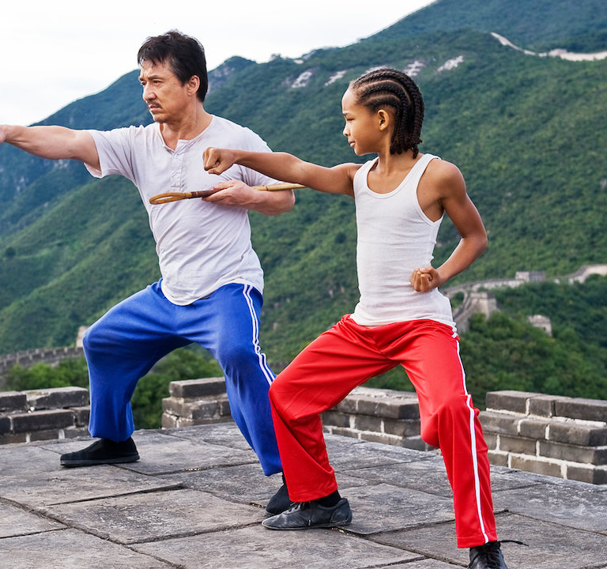
Writing 202 2-minute Instructions Project Progress Report October 22, 2020 By Himesh Buch
How to perform a Karate Kata (Shotokan Kata - Heian Shodan)

Slide 2
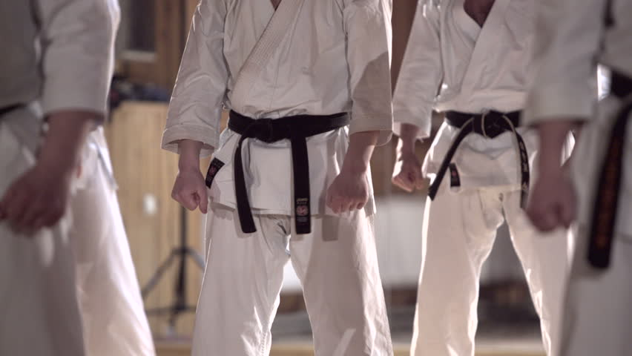
AUDIENCE & PURPOSE
SETTING & HAZARDS
PERFORMANCE OBJECTIVES
USABILITY TESTING FEEDBACK

Slide 3
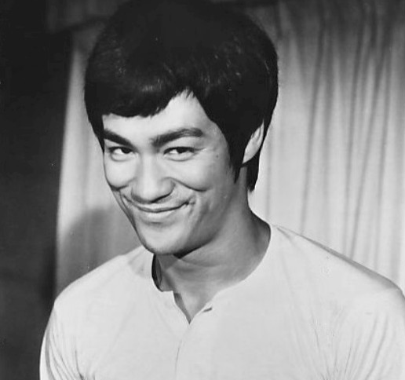
Questions?

